Slide 1
Overview of Deep Neural Networks in Image Processing
2023
Classification, Segmentation, and Multimodal Processing

Slide 2

A typical CNN architecture

Slide 3

Image filtering
1
1
1
1
1
1
1
1
1
0 | 0 | 0 | 0 | 0 | 0 | 0 | 0 | 0 | 0
0 | 0 | 0 | 0 | 0 | 0 | 0 | 0 | 0 | 0
0 | 0 | 0 | 90 | 90 | 90 | 90 | 90 | 0 | 0
0 | 0 | 0 | 90 | 90 | 90 | 90 | 90 | 0 | 0
0 | 0 | 0 | 90 | 90 | 90 | 90 | 90 | 0 | 0
0 | 0 | 0 | 90 | 0 | 90 | 90 | 90 | 0 | 0
0 | 0 | 0 | 90 | 90 | 90 | 90 | 90 | 0 | 0
0 | 0 | 0 | 0 | 0 | 0 | 0 | 0 | 0 | 0
0 | 0 | 90 | 0 | 0 | 0 | 0 | 0 | 0 | 0
0 | 0 | 0 | 0 | 0 | 0 | 0 | 0 | 0 | 0
 | 0
0 | 0 | 0 | 0 | 0 | 0 | 0 | 0 | 0 | 0
0 | 0 | 0 | 0 | 0 | 0 | 0 | 0 | 0 | 0
0 | 0 | 0 | 90 | 90 | 90 | 90 | 90 | 0 | 0
0 | 0 | 0 | 90 | 90 | 90 | 90 | 90 | 0 | 0
0 | 0 | 0 | 90 | 90 | 90 | 90 | 90 | 0 | 0
0 | 0 | 0 | 90 | 0 | 90 | 90 | 90 | 0 | 0
0 | 0 | 0 | 90 | 90 | 90 | 90 | 90 | 0 | 0
0 | 0 | 0 | 0 | 0 | 0 | 0 | 0 | 0 | 0
0 | 0 | 90 | 0 | 0 | 0 | 0 | 0 | 0 | 0
0 | 0 | 0 | 0 | 0 | 0 | 0 | 0 | 0 | 0
Credit: S. Seitz

Slide 4
Image filtering
1
1
1
1
1
1
1
1
1
0 | 0 | 0 | 0 | 0 | 0 | 0 | 0 | 0 | 0
0 | 0 | 0 | 0 | 0 | 0 | 0 | 0 | 0 | 0
0 | 0 | 0 | 90 | 90 | 90 | 90 | 90 | 0 | 0
0 | 0 | 0 | 90 | 90 | 90 | 90 | 90 | 0 | 0
0 | 0 | 0 | 90 | 90 | 90 | 90 | 90 | 0 | 0
0 | 0 | 0 | 90 | 0 | 90 | 90 | 90 | 0 | 0
0 | 0 | 0 | 90 | 90 | 90 | 90 | 90 | 0 | 0
0 | 0 | 0 | 0 | 0 | 0 | 0 | 0 | 0 | 0
0 | 0 | 90 | 0 | 0 | 0 | 0 | 0 | 0 | 0
0 | 0 | 0 | 0 | 0 | 0 | 0 | 0 | 0 | 0
 | 0 | 10
0 | 0 | 0 | 0 | 0 | 0 | 0 | 0 | 0 | 0
0 | 0 | 0 | 0 | 0 | 0 | 0 | 0 | 0 | 0
0 | 0 | 0 | 90 | 90 | 90 | 90 | 90 | 0 | 0
0 | 0 | 0 | 90 | 90 | 90 | 90 | 90 | 0 | 0
0 | 0 | 0 | 90 | 90 | 90 | 90 | 90 | 0 | 0
0 | 0 | 0 | 90 | 0 | 90 | 90 | 90 | 0 | 0
0 | 0 | 0 | 90 | 90 | 90 | 90 | 90 | 0 | 0
0 | 0 | 0 | 0 | 0 | 0 | 0 | 0 | 0 | 0
0 | 0 | 90 | 0 | 0 | 0 | 0 | 0 | 0 | 0
0 | 0 | 0 | 0 | 0 | 0 | 0 | 0 | 0 | 0
Credit: S. Seitz
Notes:
ones, divide by 9

Slide 5
Image filtering
1
1
1
1
1
1
1
1
1
0 | 0 | 0 | 0 | 0 | 0 | 0 | 0 | 0 | 0
0 | 0 | 0 | 0 | 0 | 0 | 0 | 0 | 0 | 0
0 | 0 | 0 | 90 | 90 | 90 | 90 | 90 | 0 | 0
0 | 0 | 0 | 90 | 90 | 90 | 90 | 90 | 0 | 0
0 | 0 | 0 | 90 | 90 | 90 | 90 | 90 | 0 | 0
0 | 0 | 0 | 90 | 0 | 90 | 90 | 90 | 0 | 0
0 | 0 | 0 | 90 | 90 | 90 | 90 | 90 | 0 | 0
0 | 0 | 0 | 0 | 0 | 0 | 0 | 0 | 0 | 0
0 | 0 | 90 | 0 | 0 | 0 | 0 | 0 | 0 | 0
0 | 0 | 0 | 0 | 0 | 0 | 0 | 0 | 0 | 0
 | 0 | 10 | 20
0 | 0 | 0 | 0 | 0 | 0 | 0 | 0 | 0 | 0
0 | 0 | 0 | 0 | 0 | 0 | 0 | 0 | 0 | 0
0 | 0 | 0 | 90 | 90 | 90 | 90 | 90 | 0 | 0
0 | 0 | 0 | 90 | 90 | 90 | 90 | 90 | 0 | 0
0 | 0 | 0 | 90 | 90 | 90 | 90 | 90 | 0 | 0
0 | 0 | 0 | 90 | 0 | 90 | 90 | 90 | 0 | 0
0 | 0 | 0 | 90 | 90 | 90 | 90 | 90 | 0 | 0
0 | 0 | 0 | 0 | 0 | 0 | 0 | 0 | 0 | 0
0 | 0 | 90 | 0 | 0 | 0 | 0 | 0 | 0 | 0
0 | 0 | 0 | 0 | 0 | 0 | 0 | 0 | 0 | 0
Credit: S. Seitz
Notes:
ones, divide by 9

Slide 6
Image filtering
1
1
1
1
1
1
1
1
1
0 | 0 | 0 | 0 | 0 | 0 | 0 | 0 | 0 | 0
0 | 0 | 0 | 0 | 0 | 0 | 0 | 0 | 0 | 0
0 | 0 | 0 | 90 | 90 | 90 | 90 | 90 | 0 | 0
0 | 0 | 0 | 90 | 90 | 90 | 90 | 90 | 0 | 0
0 | 0 | 0 | 90 | 90 | 90 | 90 | 90 | 0 | 0
0 | 0 | 0 | 90 | 0 | 90 | 90 | 90 | 0 | 0
0 | 0 | 0 | 90 | 90 | 90 | 90 | 90 | 0 | 0
0 | 0 | 0 | 0 | 0 | 0 | 0 | 0 | 0 | 0
0 | 0 | 90 | 0 | 0 | 0 | 0 | 0 | 0 | 0
0 | 0 | 0 | 0 | 0 | 0 | 0 | 0 | 0 | 0
 | 0 | 10 | 20 | 30
0 | 0 | 0 | 0 | 0 | 0 | 0 | 0 | 0 | 0
0 | 0 | 0 | 0 | 0 | 0 | 0 | 0 | 0 | 0
0 | 0 | 0 | 90 | 90 | 90 | 90 | 90 | 0 | 0
0 | 0 | 0 | 90 | 90 | 90 | 90 | 90 | 0 | 0
0 | 0 | 0 | 90 | 90 | 90 | 90 | 90 | 0 | 0
0 | 0 | 0 | 90 | 0 | 90 | 90 | 90 | 0 | 0
0 | 0 | 0 | 90 | 90 | 90 | 90 | 90 | 0 | 0
0 | 0 | 0 | 0 | 0 | 0 | 0 | 0 | 0 | 0
0 | 0 | 90 | 0 | 0 | 0 | 0 | 0 | 0 | 0
0 | 0 | 0 | 0 | 0 | 0 | 0 | 0 | 0 | 0
Credit: S. Seitz

Slide 7
Image filtering
1
1
1
1
1
1
1
1
1
0 | 0 | 0 | 0 | 0 | 0 | 0 | 0 | 0 | 0
0 | 0 | 0 | 0 | 0 | 0 | 0 | 0 | 0 | 0
0 | 0 | 0 | 90 | 90 | 90 | 90 | 90 | 0 | 0
0 | 0 | 0 | 90 | 90 | 90 | 90 | 90 | 0 | 0
0 | 0 | 0 | 90 | 90 | 90 | 90 | 90 | 0 | 0
0 | 0 | 0 | 90 | 0 | 90 | 90 | 90 | 0 | 0
0 | 0 | 0 | 90 | 90 | 90 | 90 | 90 | 0 | 0
0 | 0 | 0 | 0 | 0 | 0 | 0 | 0 | 0 | 0
0 | 0 | 90 | 0 | 0 | 0 | 0 | 0 | 0 | 0
0 | 0 | 0 | 0 | 0 | 0 | 0 | 0 | 0 | 0
 | 0 | 10 | 20 | 30 | 30
Credit: S. Seitz

Slide 8
Image filtering
1
1
1
1
1
1
1
1
1
0 | 0 | 0 | 0 | 0 | 0 | 0 | 0 | 0 | 0
0 | 0 | 0 | 0 | 0 | 0 | 0 | 0 | 0 | 0
0 | 0 | 0 | 90 | 90 | 90 | 90 | 90 | 0 | 0
0 | 0 | 0 | 90 | 90 | 90 | 90 | 90 | 0 | 0
0 | 0 | 0 | 90 | 90 | 90 | 90 | 90 | 0 | 0
0 | 0 | 0 | 90 | 0 | 90 | 90 | 90 | 0 | 0
0 | 0 | 0 | 90 | 90 | 90 | 90 | 90 | 0 | 0
0 | 0 | 0 | 0 | 0 | 0 | 0 | 0 | 0 | 0
0 | 0 | 90 | 0 | 0 | 0 | 0 | 0 | 0 | 0
0 | 0 | 0 | 0 | 0 | 0 | 0 | 0 | 0 | 0
 | 0 | 10 | 20 | 30 | 30
?
Credit: S. Seitz

Slide 9
Image filtering
1
1
1
1
1
1
1
1
1
0 | 0 | 0 | 0 | 0 | 0 | 0 | 0 | 0 | 0
0 | 0 | 0 | 0 | 0 | 0 | 0 | 0 | 0 | 0
0 | 0 | 0 | 90 | 90 | 90 | 90 | 90 | 0 | 0
0 | 0 | 0 | 90 | 90 | 90 | 90 | 90 | 0 | 0
0 | 0 | 0 | 90 | 90 | 90 | 90 | 90 | 0 | 0
0 | 0 | 0 | 90 | 0 | 90 | 90 | 90 | 0 | 0
0 | 0 | 0 | 90 | 90 | 90 | 90 | 90 | 0 | 0
0 | 0 | 0 | 0 | 0 | 0 | 0 | 0 | 0 | 0
0 | 0 | 90 | 0 | 0 | 0 | 0 | 0 | 0 | 0
0 | 0 | 0 | 0 | 0 | 0 | 0 | 0 | 0 | 0
 | 0 | 10 | 20 | 30 | 30
 |  |  |  | 50
?
Credit: S. Seitz

Slide 10
Image filtering
1
1
1
1
1
1
1
1
1
0 | 0 | 0 | 0 | 0 | 0 | 0 | 0 | 0 | 0
0 | 0 | 0 | 0 | 0 | 0 | 0 | 0 | 0 | 0
0 | 0 | 0 | 90 | 90 | 90 | 90 | 90 | 0 | 0
0 | 0 | 0 | 90 | 90 | 90 | 90 | 90 | 0 | 0
0 | 0 | 0 | 90 | 90 | 90 | 90 | 90 | 0 | 0
0 | 0 | 0 | 90 | 0 | 90 | 90 | 90 | 0 | 0
0 | 0 | 0 | 90 | 90 | 90 | 90 | 90 | 0 | 0
0 | 0 | 0 | 0 | 0 | 0 | 0 | 0 | 0 | 0
0 | 0 | 90 | 0 | 0 | 0 | 0 | 0 | 0 | 0
0 | 0 | 0 | 0 | 0 | 0 | 0 | 0 | 0 | 0
 | 0 | 10 | 20 | 30 | 30 | 30 | 20 | 10
 | 0 | 20 | 40 | 60 | 60 | 60 | 40 | 20
 | 0 | 30 | 60 | 90 | 90 | 90 | 60 | 30
 | 0 | 30 | 50 | 80 | 80 | 90 | 60 | 30
 | 0 | 30 | 50 | 80 | 80 | 90 | 60 | 30
 | 0 | 20 | 30 | 50 | 50 | 60 | 40 | 20
 | 10 | 20 | 30 | 30 | 30 | 30 | 20 | 10
 | 10 | 10 | 10 | 0 | 0 | 0 | 0 | 0
Credit: S. Seitz

Slide 11
Filter Kernel ( نواة ) Weights
The convolution operator (3 by 3 for example) is called the (filter kernel). It would have 9 coefficients (weights)
In traditional image processing, this kernel weights are fixed and are designed to do some matching (edges, corners, blobs, etc.)
In the CNN, these weights are going to be adaptive (learned) from the training data.

Slide 12

Examples of different filters in image processing: filter weights are fixed in the image processing domain

Slide 13

Different filters = multiple feature maps

Slide 14
The usual structure of CNN
1- Convolution layer: produces feature maps
2- Relu (or Gelu, Swish, etc.) on the feature map values
3- Pooling (Max pooling) layer
Then repeat many layers,
4- Followed by one or more classification (fully-connected-Dense layers)
5- and finally, a Softmax layer (if classification) or a Regression layer

Slide 15
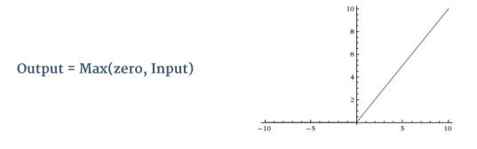


Slide 16
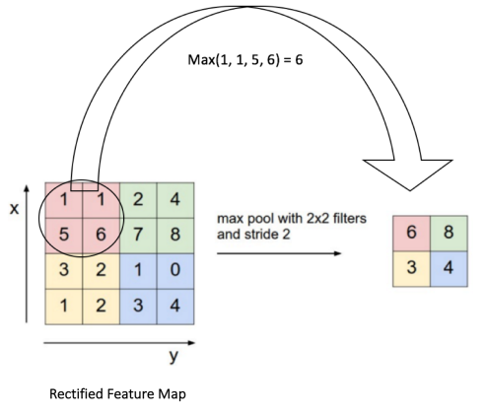
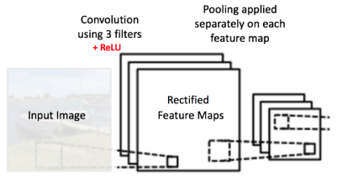

Slide 17
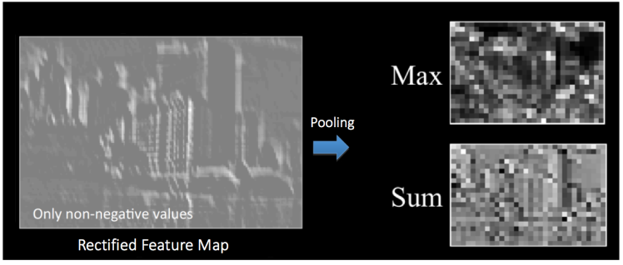

Slide 18
A typical CNN architecture

Slide 19
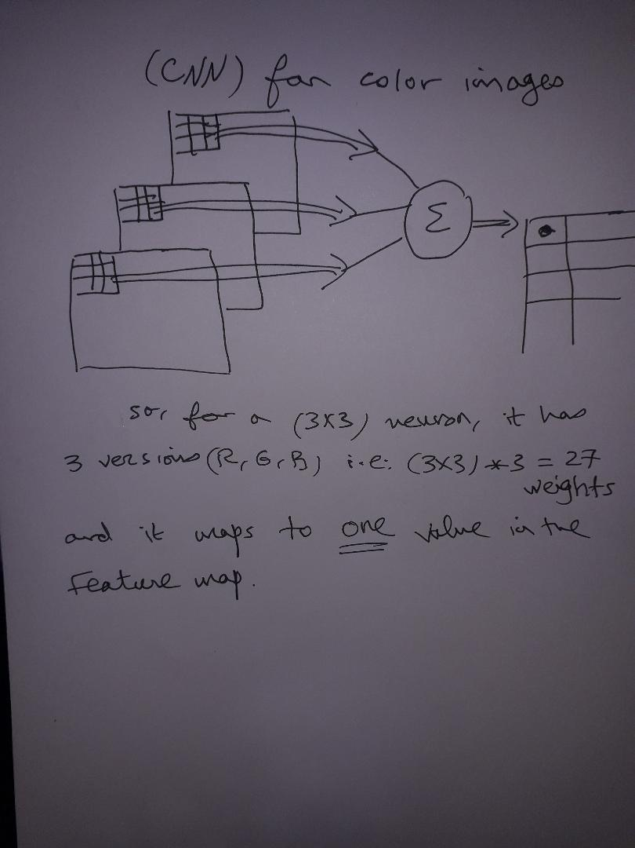

Slide 20
So, how depth works in each layer?
So, for the 1st layer; it has 4 feature maps. We consider this as an image with depth 4 (like the RGB image has depth 3)
So, we apply 12 neurons (12 different filters) on the depth-4 layer. So, each neuron has (5x5)x4 weights (5x5 and depth 4).
And, at each position of the filter, the outputs from the 4 depths are summed to produce the next layer feature map.

Slide 21
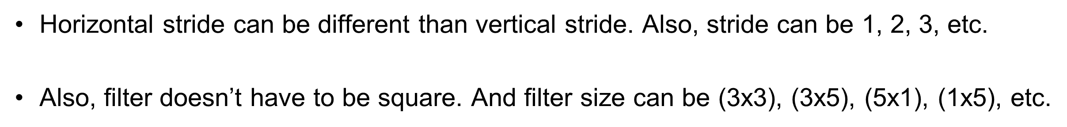
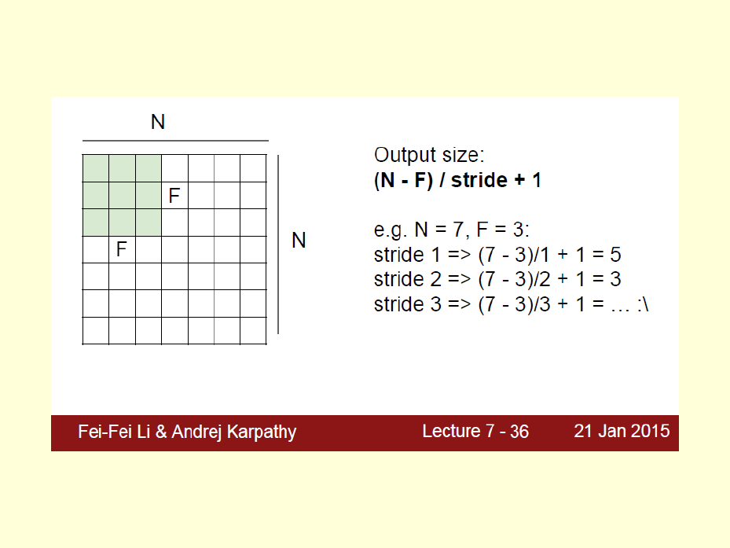

Slide 22
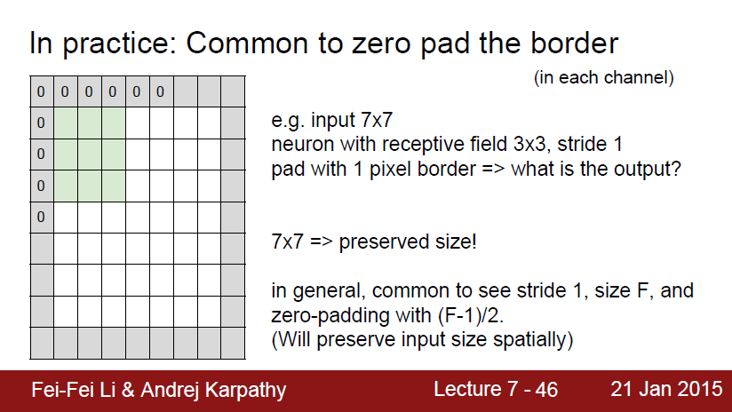

Slide 23
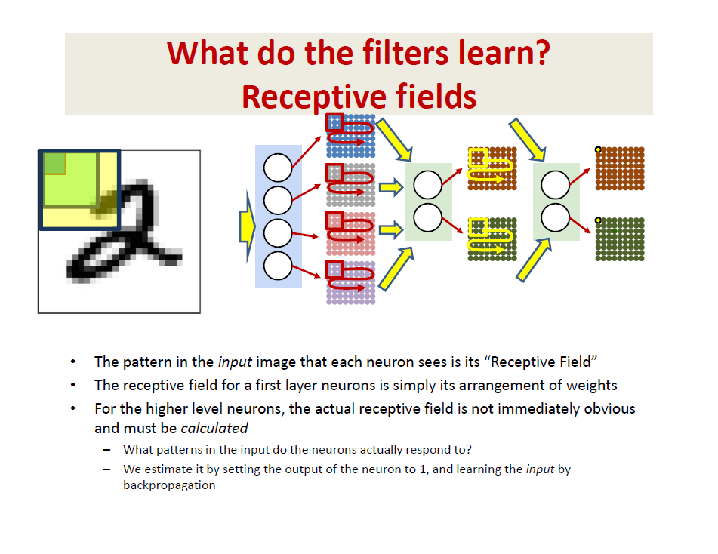

Slide 24
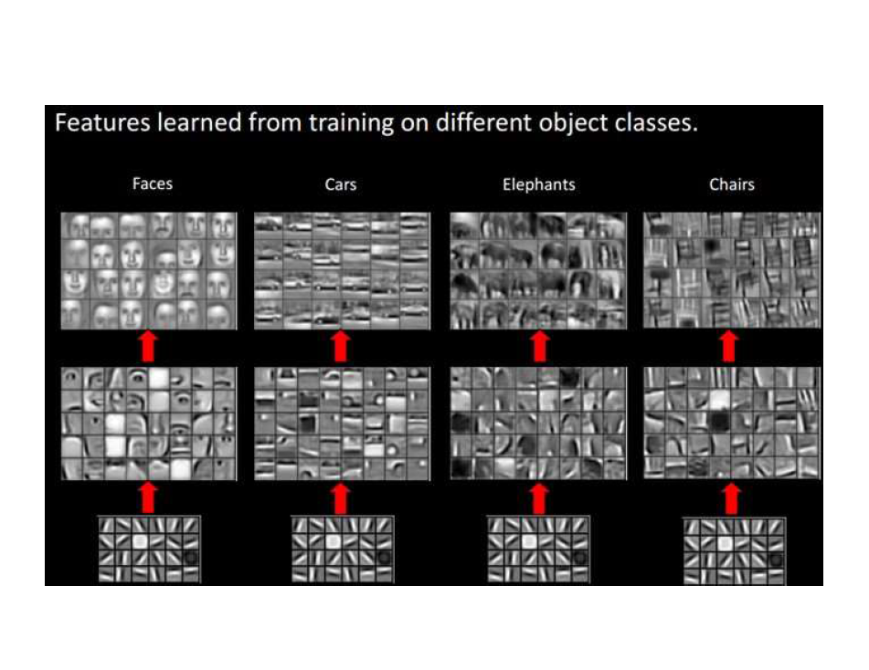

Slide 25
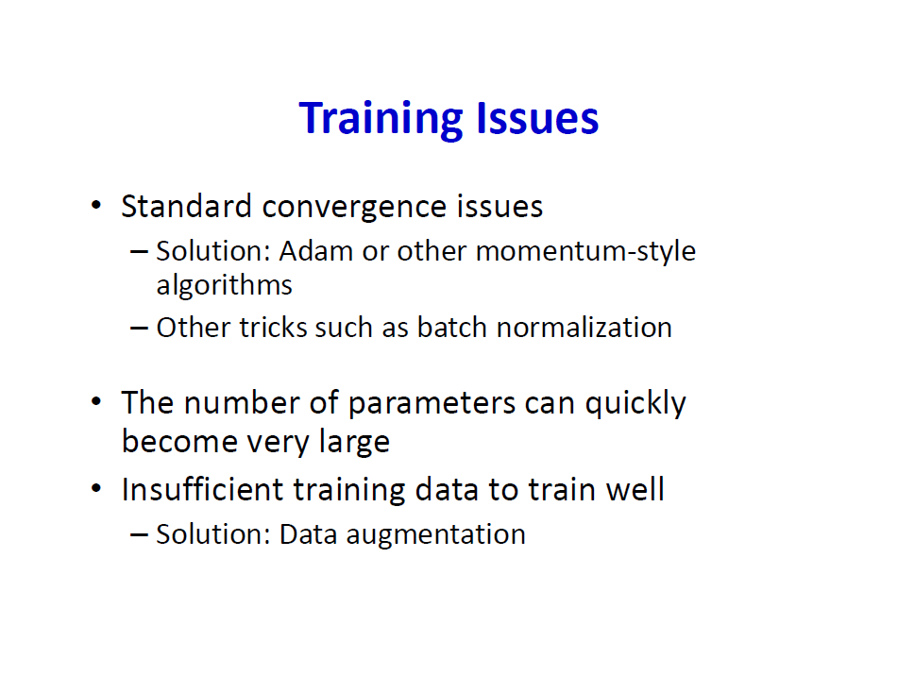

Slide 26
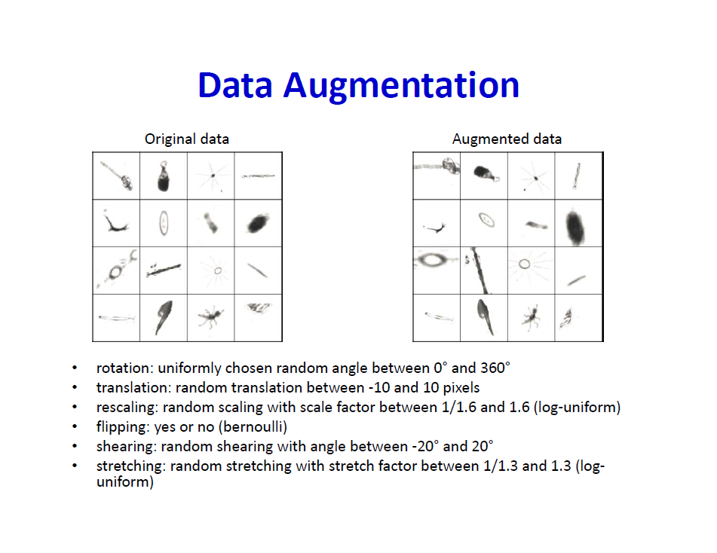

Slide 27
Data Augmentation
Usually, a small number of examples are available for each class.
Also, we need the network to be robust against noise, degradation, rotations, cropping, etc.
During training, multiple image transformations can be applied: flipping of the images alongside the horizontal and vertical axis, rotation of up to 10°, zooming of up to 110%, adding of random lightning, adding noise, compression, cropping and rescaling, translation, etc.
Using augmentation has offered clear performance improvements in computer vision applications

Slide 28
Transfer Learning
Google, Facebook (Meta), MS and others have trained computer-vision CNN networks
These are trained on millions of images and thousands of classes (objects)
These pre-trained CNN networks are available to everyone to use for their own applications
We use these models like feature extractors and construct output layers on top of them.
Most famous are: VGG16, VGG19, Resnet50, InceptionNet, MobileNet, AlexNet, etc.

Slide 29
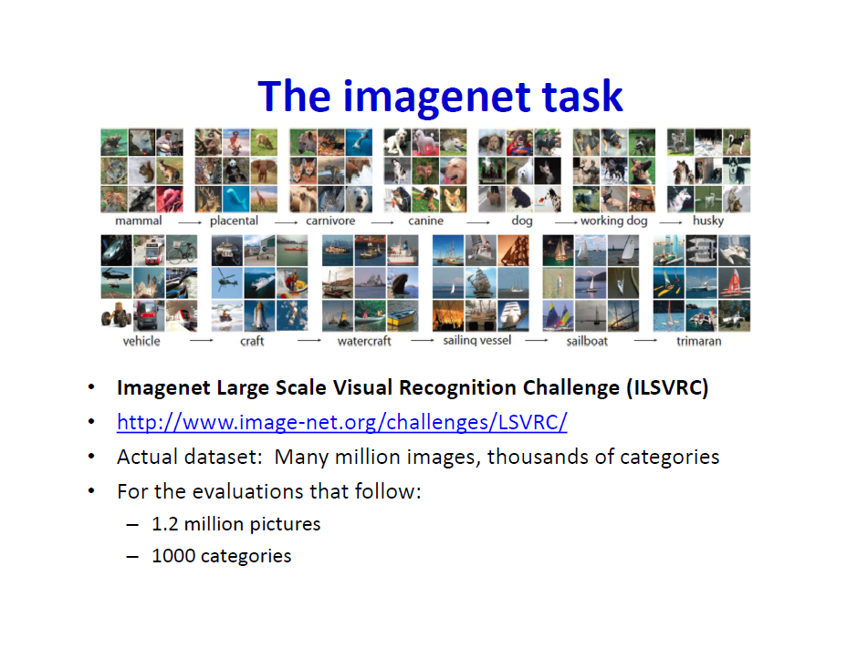
Pascal VOC 2012 and COCO for object detection and semantic segmentation

Slide 30
Transfer Learning Paradigms
Pre-trained CNN models (AlexNet, VGG, ResNet, DenseNet, InceptionNet) are used with 2 different approaches:
Fine-Tune the deep models after adding fully connected output layers and training with the new challenge data
Use pre-trained models as feature extraction and apply traditional ML techniques (LR, MLP, SVM, RF or XGBoost)

Slide 31
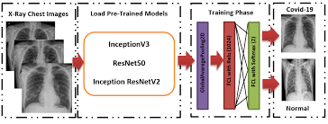
A. Fine Tune the pre-trained model
A- Use extra output layers and fine tune the architecture to the new data (transfer learning)

Slide 32
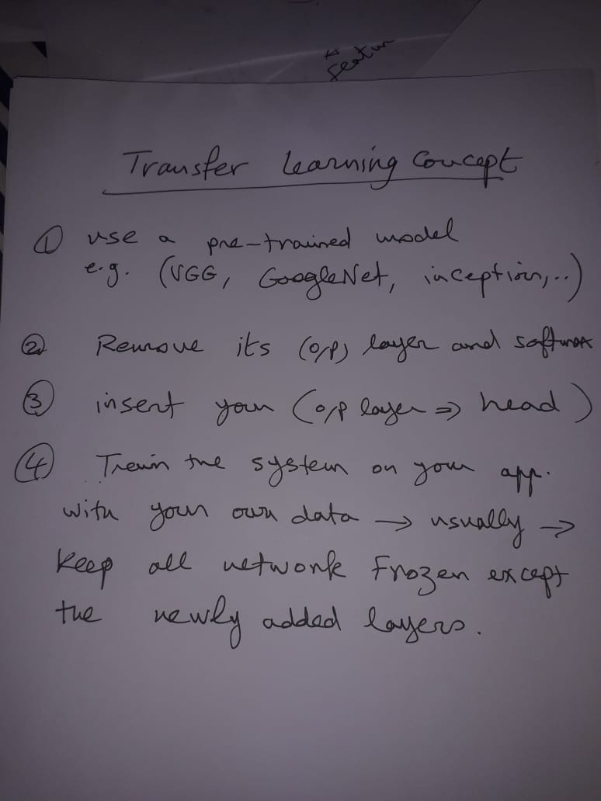
First Approach of Transfer Learning

Slide 33
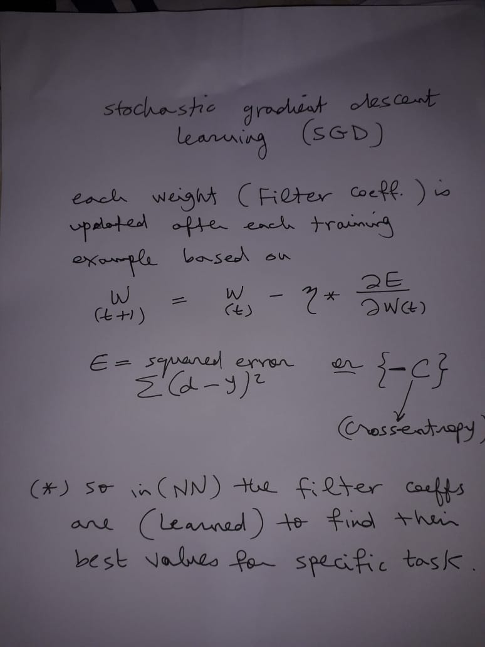

Slide 34
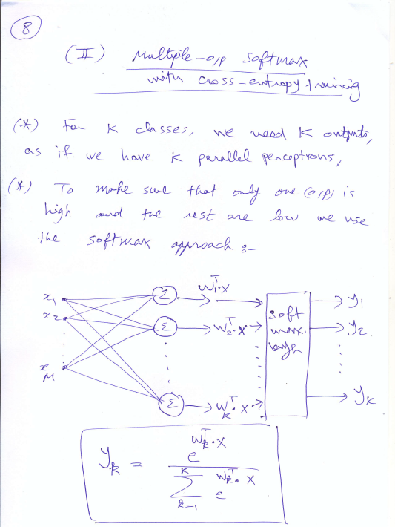

Slide 35
B. Extract Deep Features and use ML
Have been used with 2 different approaches:
B- Using pre-trained deep neural network models as feature extractors

Slide 36
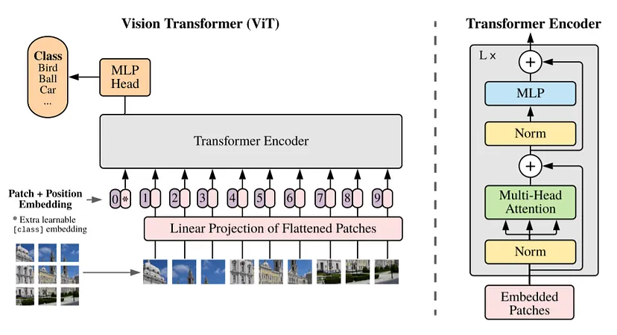
New Trend: Vision Transformer (ViT)

Slide 37
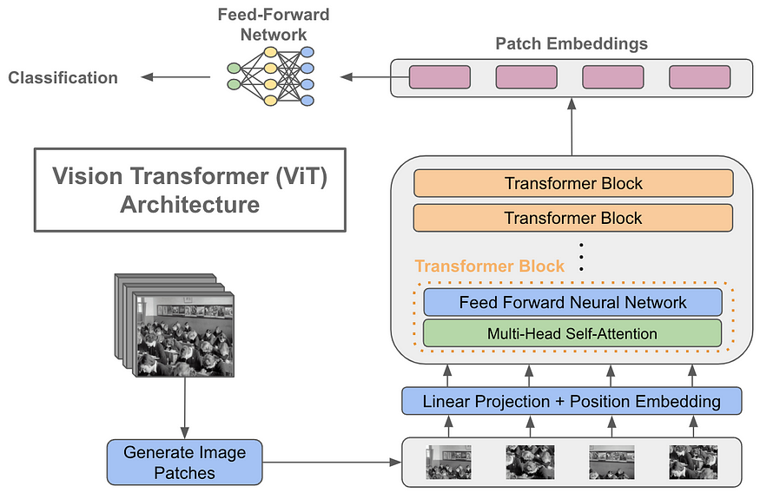

Slide 38
Deep Image Segmentation

Slide 39
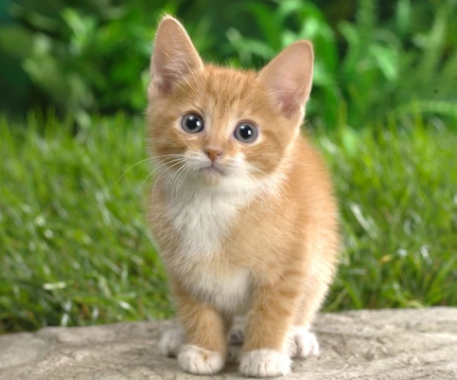
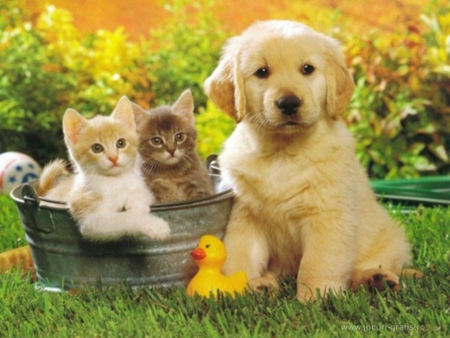

Computer Vision Tasks
Classification
+ Localization
Instance Segmentation
Classification
Object Detection
CAT
CAT
CAT, DOG, DUCK
CAT, DOG, DUCK
Single object
Multiple objects
Fei-Fei Li & Andrej Karpathy & Justin Johnson Lecture 8 - 1 Feb 2016
Lecture 8 -
8

Slide 40
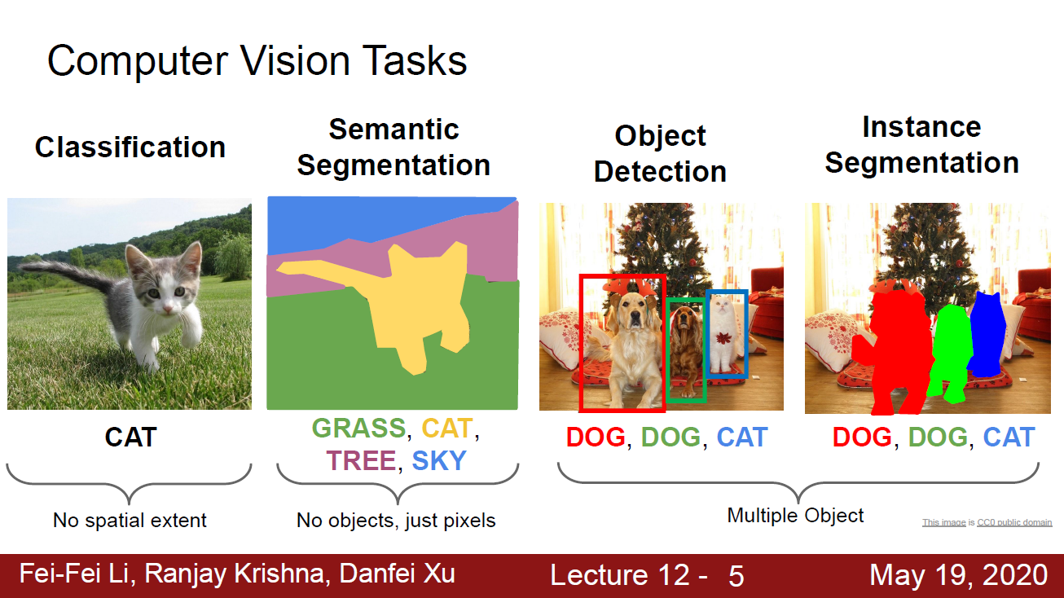

Slide 41
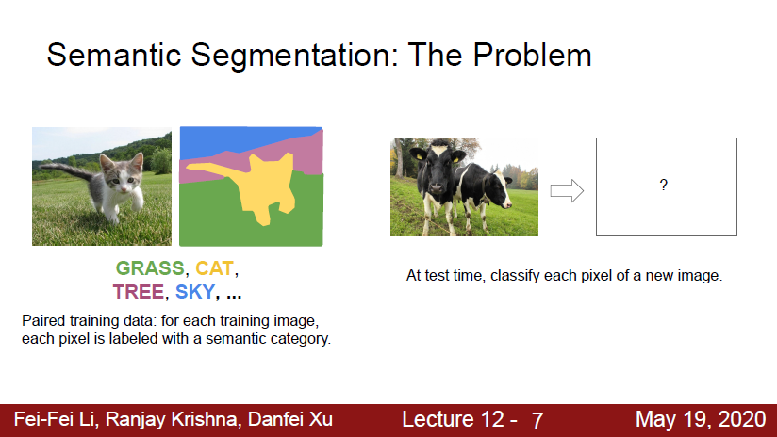

Slide 42
Fully Convolutional Network for Semantic Segmentation
A Fully Convolutional neural network (FCN) is a normal CNN in its first half, but a different CNN in the second half,
FCNs use convolutional layers to classify each pixel in the image.
The goal of FCNs is to produce “semantic segmentation”, with an output that is the same size as the original input image, but in which each pixel in the image is colored one of X colors, where X is the number of classes we are segmenting.

Slide 43
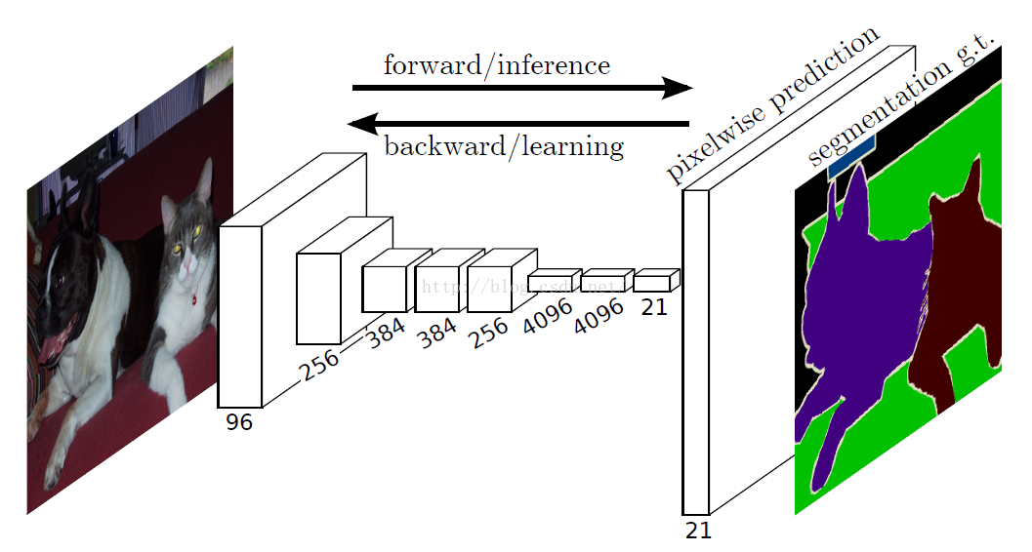
Fully Convolutional Network for Segmentation

Slide 44
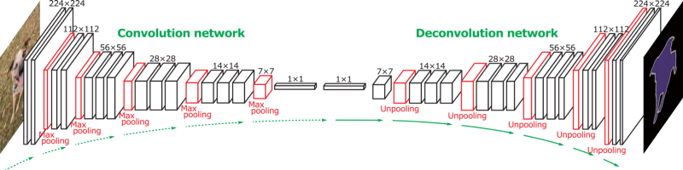
FCN Layers
FCNs use “deconvolutions”, or essentially backwards convolutions, to up sample, so that output match the width and height of the original input image.

Slide 45
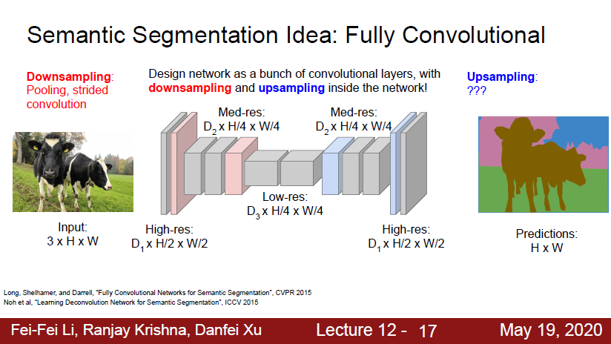

Slide 46
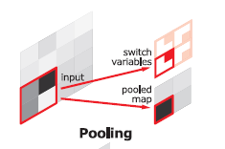
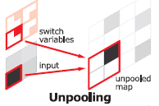
Unpooling
Pooling | Up Pooling
Max. pooling Store position of maximum value in a switch variable and then create a pooling map. | Use switch variable created by pooling layer to place each activation value to its original location.

Slide 47
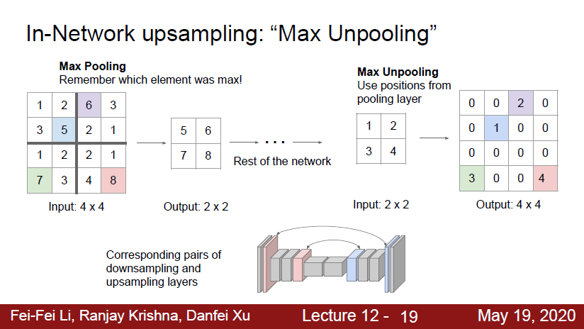

Slide 48
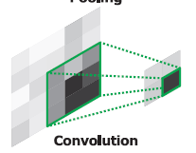
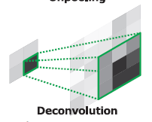
Deconvolution: Transposed Convolution
Convolution | Deconvolution
Connect multiple input activations within a filter window to a single activation | Associate a single input activation within multiple outputs

Slide 49


Transposed convolution different padding strategies

Slide 50
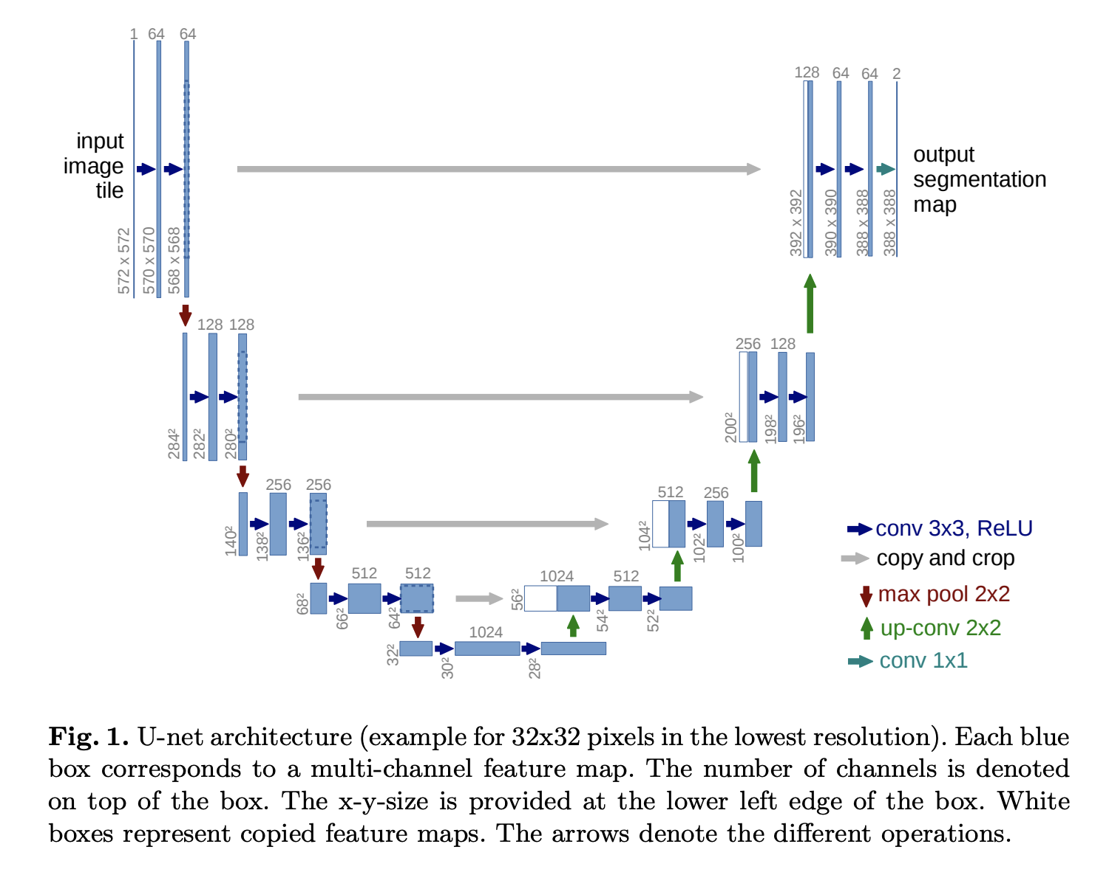
State of the art: The UNET

Slide 51
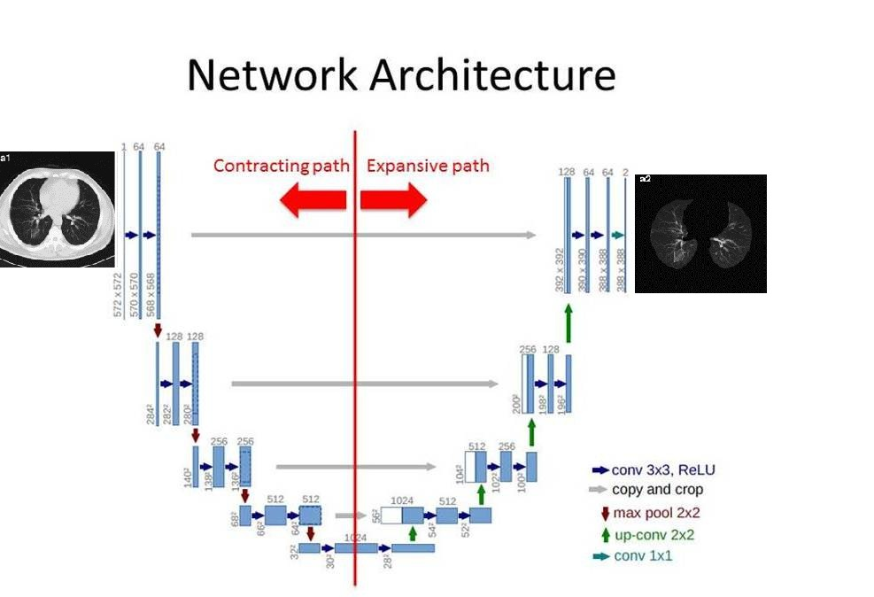
Every step in the expansive path consists of an up-sampling of the feature map followed by a 2x2 convolution (“up-convolution”) that halves the number of feature channels, a concatenation with the correspondingly cropped feature map from the contracting path, and two 3x3 convolutions, each followed by a ReLU

Slide 52
To get better precise locations, at every step of the decoder we use skip connections by concatenating the output of the transposed convolution layers with the feature maps from the Encoder at the same level: u6 = u6 + c4 u7 = u7 + c3 u8 = u8 + c2 u9 = u9 + c1 After every concatenation we again apply two consecutive regular convolutions so that the model can learn to assemble a more precise output

Slide 53

Computer Vision Tasks
Classification
+ Localization
Instance Segmentation
Classification
Object Detection
CAT
CAT
CAT, DOG, DUCK
CAT, DOG, DUCK
Single object
Multiple objects
Fei-Fei Li & Andrej Karpathy & Justin Johnson Lecture 8 - 1 Feb 2016
Lecture 8 -
8

Slide 54



Computer Vision Tasks
Classification
+ Localization
Instance Segmentation
Classification
Object Detection
Fei-Fei Li & Andrej Karpathy & Justin Johnson Lecture 8 - 1 Feb 2016
Lecture 8 -
9

Slide 55
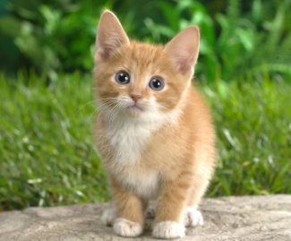
Classification + Localization: Task
Classification: C classes
Input: Image
Output: Class label
Evaluation metric: Accuracy
CAT
Localization:
Input: Image
Output: Box in the image (x, y, w, h)
Evaluation metric: Intersection over Union
(x, y, w, h)
Classification + Localization: Do both
Fei-Fei Li & Andrej Karpathy & Justin Johnson Lecture 8 - 1 Feb 2016
Lecture 8 - 10

Slide 56
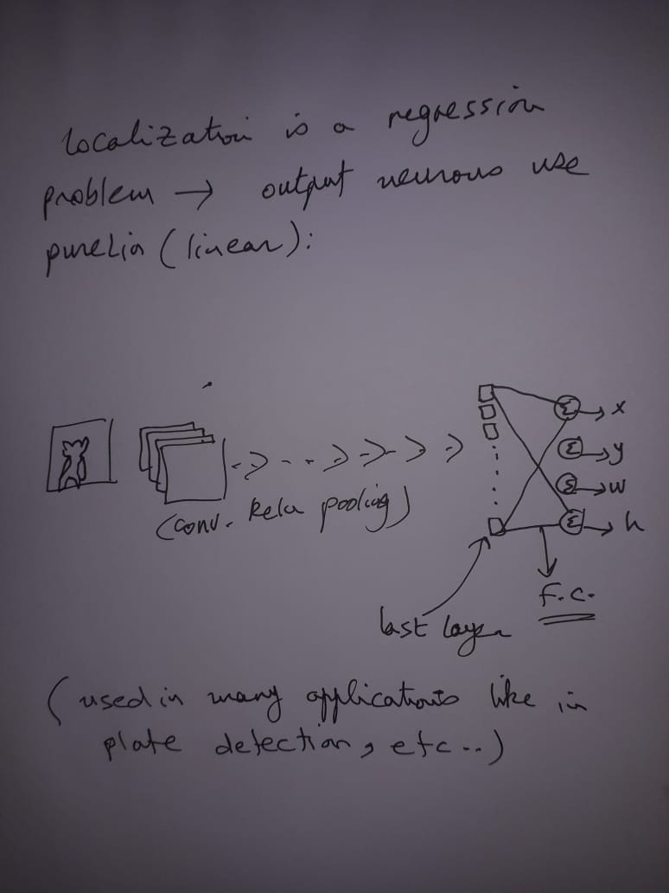

Slide 57
Idea #1: Localization as Regression
Input: image
CNN Neural Net
Output:
Box coordinates (4 numbers)
Loss: squared error min.
Correct output: box coordinates 4 numbers
Only one object
Fei-Fei Li & Andrej Karpathy & Justin Johnson Lecture 8 - 1 Feb 2016
Lecture 8 - 12

Slide 58

Simple Recipe for Classification + Localization
Step 1: Train (or download) a classification model (AlexNet, VGG, GoogLeNet):
These are pre-trained deep models (transfer learning concept: see next slide)
Convolution and Pooling
Fully-connected layers
Softmax loss
Final conv feature map
Class scores
Image
Fei-Fei Li & Andrej Karpathy & Justin Johnson Lecture 8 - 1 Feb 2016
Lecture 8 - 13

Slide 60
Simple Recipe for Classification + Localization
Step 2: Attach new fully-connected “regression head” to the network
Fully-connected layers
“Classification head”
Convolution and Pooling
Class scores
Fully-connected layers
“Regression head”
Final conv feature map
Image
Box coordinates
Fei-Fei Li & Andrej Karpathy & Justin Johnson Lecture 8 - 1 Feb 2016
Lecture 8 - 14

Slide 61
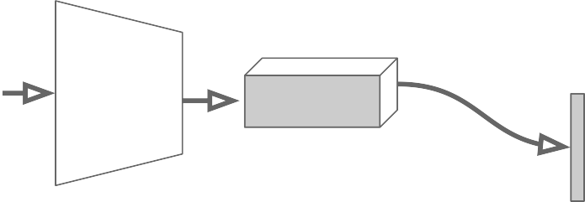
Simple Recipe for Classification + Localization
Step 3: Train the regression head only with SGD and L2 loss
Fully-connected layers
Convolution and Pooling
Class scores
Fully-connected layers
L2 loss
Final conv feature map
Image
Box coordinates
Fei-Fei Li & Andrej Karpathy & Justin Johnson Lecture 8 - 1 Feb 2016
Lecture 8 - 15

Slide 62
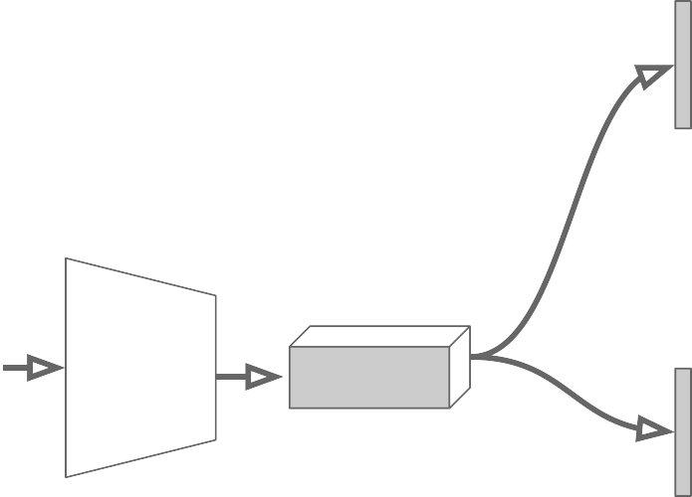
Simple Recipe for Classification + Localization
Step 4: At test time use both heads
Fully-connected layers
Convolution and Pooling
Class scores
Fully-connected layers
Final conv feature map
Image
Box coordinates
Fei-Fei Li & Andrej Karpathy & Justin Johnson Lecture 8 - 1 Feb 2016
Lecture 8 - 16

Slide 63
Idea #2: Sliding Window
Run classification + regression network at multiple locations on a high- resolution image
Convert fully-connected layers into convolutional layers for efficient computation
Combine classifier and
regressor predictions across all scales for final prediction
Fei-Fei Li & Andrej Karpathy & Justin Johnson Lecture 8 - 1 Feb 2016
Lecture 8 - 22

Slide 64
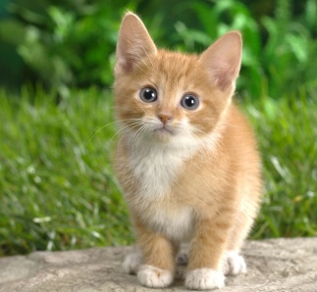
Sliding Window: Overfeat
4096
4096
Class scores: 1000
FC
FC
Convolution
+ pooling
Softmax loss
FC
FC
Feature map: 1024 x 5 x 5
FC
FC
Image:
3 x 221 x 221
Euclidean loss
1024
Boxes: 1000 x 4
4096
Fei-Fei Li & Andrej Karpathy & Justin Johnson Lecture 8 - 1 Feb 2016
Lecture 8 - 23

Slide 65

Sliding Window: Overfeat
Network input: 3 x 221 x 221
Larger image: 3 x 257 x 257
Fei-Fei Li & Andrej Karpathy & Justin Johnson Lecture 8 - 1 Feb 2016
Lecture 8 - 24

Slide 66
Sliding Window: Overfeat classification: takes the input window and produces a score. Regression: takes the layer-5 pooled features and produces a bounding box estimate (which can be outside the window)
0.5
Network input: 3 x 221 x 221
Larger image: 3 x 257 x 257
Classification scores: P(cat)
Fei-Fei Li & Andrej Karpathy & Justin Johnson Lecture 8 - 1 Feb 2016
Lecture 8 - 25

Slide 67
Sliding Window: Overfeat
0.5 | 0.75
Network input: 3 x 221 x 221
Larger image: 3 x 257 x 257
Classification scores: P(cat)
Fei-Fei Li & Andrej Karpathy & Justin Johnson Lecture 8 - 1 Feb 2016
Lecture 8 - 26

Slide 68
Sliding Window: Overfeat
0.5 | 0.75
0.6
Network input: 3 x 221 x 221
Larger image: 3 x 257 x 257
Classification scores: P(cat)
Fei-Fei Li & Andrej Karpathy & Justin Johnson Lecture 8 - 1 Feb 2016
Lecture 8 - 27

Slide 69
Sliding Window: Overfeat
0.5 | 0.75
0.6 | 0.8
Network input: 3 x 221 x 221
Larger image: 3 x 257 x 257
Classification scores: P(cat)
Fei-Fei Li & Andrej Karpathy & Justin Johnson Lecture 8 - 1 Feb 2016
Lecture 8 - 28

Slide 70
Sliding Window: Overfeat each estimated bounding box has an associated confidence. They are merged boxes to get the unified estimate.
0.5 | 0.75
0.6 | 0.8
Network input: 3 x 221 x 221
Larger image: 3 x 257 x 257
Classification scores: P(cat)
Fei-Fei Li & Andrej Karpathy & Justin Johnson Lecture 8 - 1 Feb 2016
Lecture 8 - 29

Slide 71
Sliding Window: Overfeat
0.8
Network input: 3 x 221 x 221
Larger image: 3 x 257 x 257
Classification score: P (cat)
Fei-Fei Li & Andrej Karpathy & Justin Johnson Lecture 8 - 1 Feb 2016
Lecture 8 - 30

Slide 72
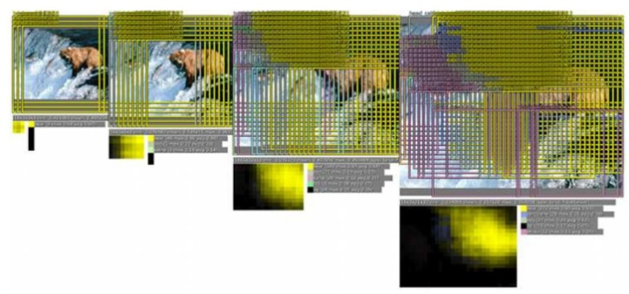
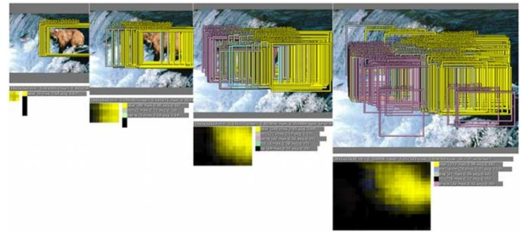
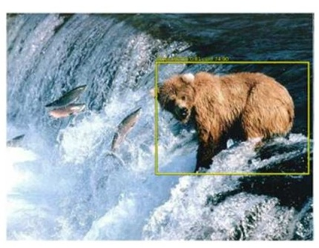
Sliding Window: Overfeat
In practice they used many sliding window locations and multiple scales
Window positions + score maps
Box regression outputs
Final Predictions
Fei-Fei Li & Andrej Karpathy & Justin Johnson Lecture 8 - 1 Feb 2016
Lecture 8 - 31

Slide 73
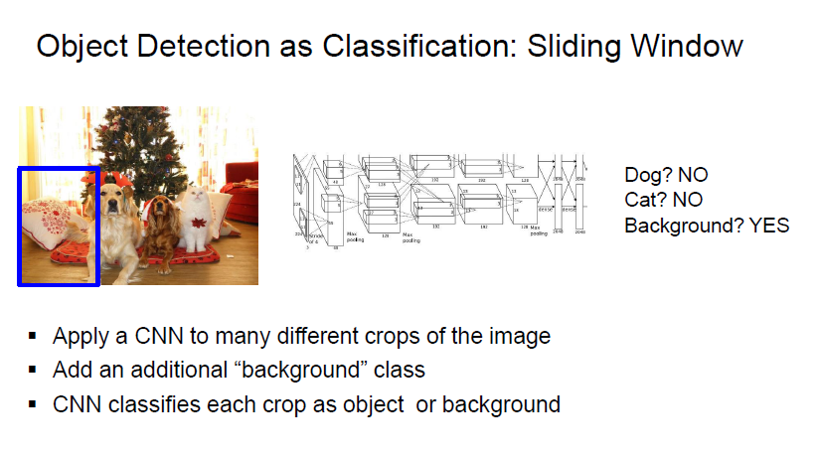
So, the sliding window idea is a promising one:

Slide 74
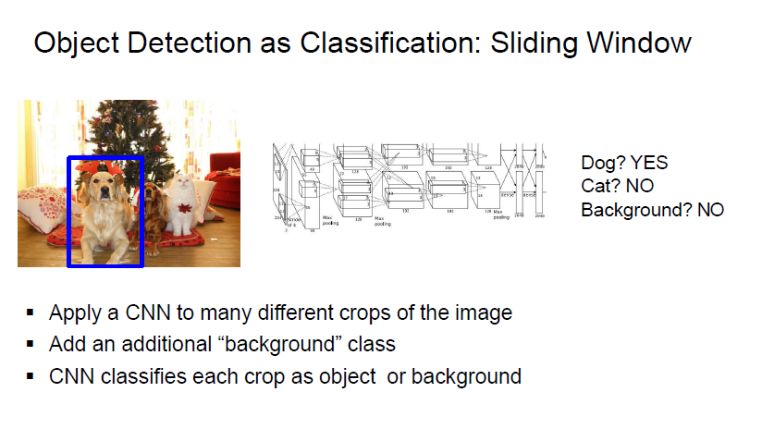

Slide 75
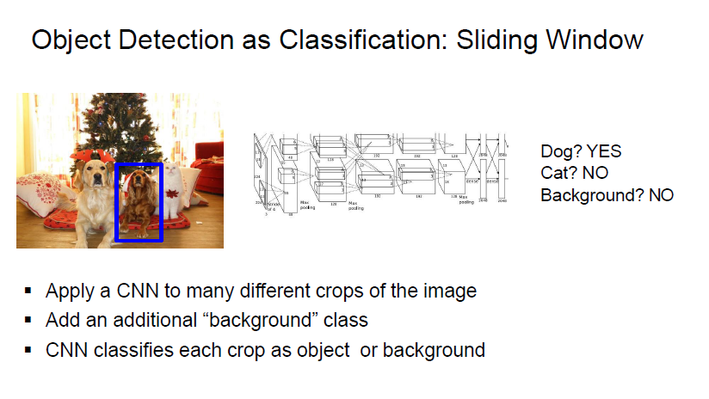

Slide 76
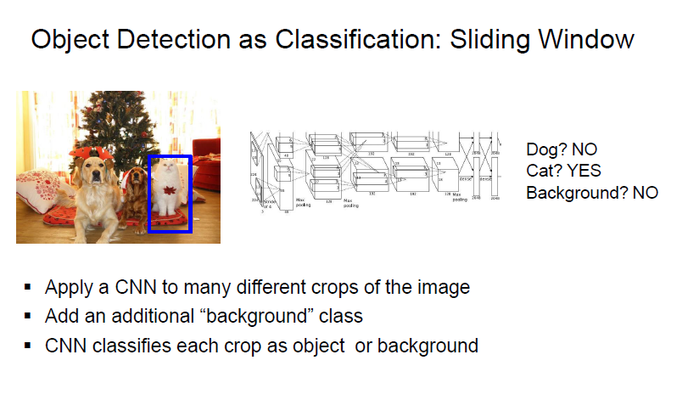

Slide 77
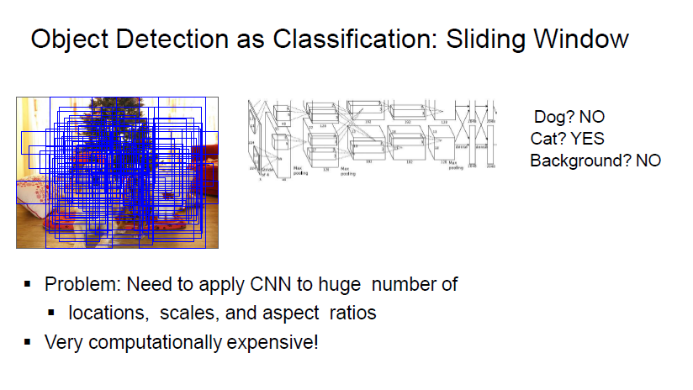

Slide 78
So, Detection as Classification
Problem: Need to test many positions and scales, and use a computationally demanding classifier (CNN)
Solution: Only look at a tiny subset of possible positions
Fei-Fei Li & Andrej Karpathy & Justin Johnson Lecture 8 - 1 Feb 2016
Lecture 8 - 48

Slide 79
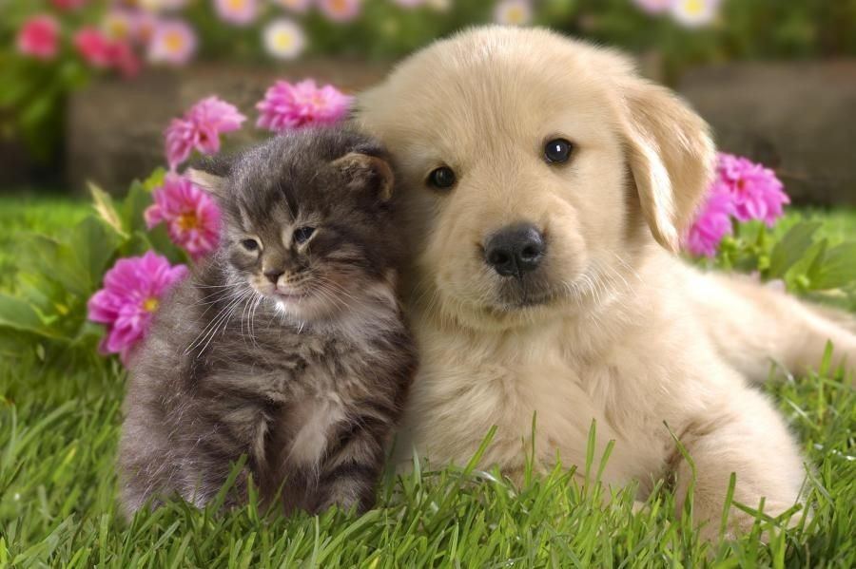
Region Proposals
Find “blobby” image regions that are likely to contain objects
“Class-agnostic” object detector
Look for “blob-like” regions
Fei-Fei Li & Andrej Karpathy & Justin Johnson Lecture 8 - 1 Feb 2016
Lecture 8 - 49

Slide 80
(Region-Proposal CNN: R-CNN)
The first step is to do a “selective search”.
Propose category-independent regions of interest by selective search (~2k candidates per image). Those regions may contain target objects and they are of different sizes.
This could be done using traditional techniques like (SIFT, HOG, Color, etc.)

Slide 81
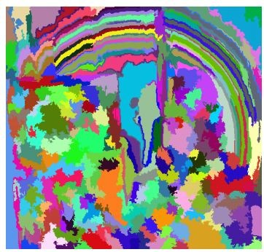
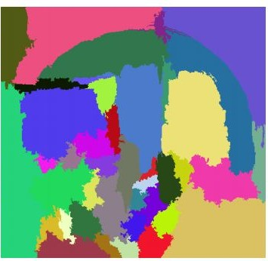
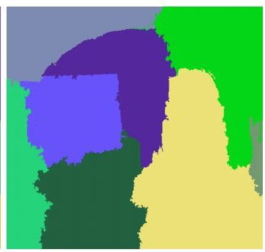



Region Proposals: Selective Search
Bottom-up segmentation, merging regions at multiple scales
Convert regions to boxes
Fei-Fei Li & Andrej Karpathy & Justin Johnson Lecture 8 - 1 Feb 2016
Lecture 8 - 50

Slide 82
R-CNN Training
Step 1: Train (or download) a classification model for ImageNet (AlexNet)
Convolution and Pooling
Fully-connected layers
Softmax loss
Final conv feature map
Class scores 1000 classes
Image
Fei-Fei Li & Andrej Karpathy & Justin Johnson Lecture 8 - 1 Feb 2016
Lecture 8 - 54

Slide 83
R-CNN Training
Step 2: Fine-tune model for detection
Instead of 1000 ImageNet classes, want 20 object classes + background
Throw away final fully-connected layer, reinitialize from scratch
Re-initialize this layer: was 4096 x 1000,
now will be 4096 x 21
Convolution and Pooling
Fully-connected layers
Softmax loss
Final conv feature map
Class scores: 21 classes
Image
Fei-Fei Li & Andrej Karpathy & Justin Johnson Lecture 8 - 1 Feb 2016
Lecture 8 - 55

Slide 84



R-CNN Training
Step 3: Extract features
Extract region proposals for all images using selective search
For each region: warp to CNN input size, run forward through CNN, save pool5 features to disk
Have a big hard drive: features are ~200GB for PASCAL dataset!
Convolution and Pooling
pool5 features
Image
Region Proposals
Crop + Warp
Forward pass
Save to disk
Fei-Fei Li & Andrej Karpathy & Justin Johnson Lecture 8 - 1 Feb 2016
Lecture 8 - 56

Slide 85








R-CNN Training
Step 4: Train one binary SVM per class to classify region features
Training image regions
Cached region features
Positive samples for cat SVM
Negative samples for cat SVM
Fei-Fei Li & Andrej Karpathy & Justin Johnson Lecture 8 - 1 Feb 2016
Lecture 8 - 57

Slide 86


R-CNN Training
Step 4: Train one binary SVM per class to classify region features
Training image regions
Cached region features
Negative samples for dog SVM
Positive samples for dog SVM
Fei-Fei Li & Andrej Karpathy & Justin Johnson Lecture 8 - 1 Feb 2016
Lecture 8 - 58

Slide 87



R-CNN Training
Step 5 (bbox regression): For each class, train a linear regression model to map from cached features to offsets to ground-truth (GT) boxes to make up for “slightly wrong” proposals
Training image regions
Cached region features
Regression targets (dx, dy, dw, dh)
Normalized coordinates
(0, 0, 0, 0)
Proposal is good
(.25, 0, 0, 0)
Proposal too far to left
(0, 0, -0.125, 0)
Proposal too wide
Fei-Fei Li & Andrej Karpathy & Justin Johnson Lecture 8 - 1 Feb 2016
Lecture 8 - 59

Slide 88


Slide 89


Slide 90


Slide 91


Slide 92


Slide 93


Slide 94


Slide 95
R-CNN Problems
Slow at test-time: need to run full forward pass of CNN for each region proposal
SVMs and regressors are post-hoc: CNN features not updated in response to SVMs and regressors
Complex multistage training pipeline
Fei-Fei Li & Andrej Karpathy & Justin Johnson Lecture 8 - 1 Feb 2016
Lecture 8 - 66

Slide 96


Slide 97


Slide 98


Slide 99


Slide 100


Slide 101


Slide 102


Slide 103
What came Next?
Faster R-CNN (Girshick, 2016)
YOLO (Redmon, Girshick, Divvala, Farhadi, 2016)
You Only Look Once (People’s Choice Award)
YOLO9000: Better, Faster, Stronger (Redmon, Farhadi, CVPR 2017) Runner up for Best Paper
YOLOv3 → YOLOv7 (2022)

Slide 104


Slide 105


Slide 106


Slide 107


Slide 108


Slide 109


Slide 110


Slide 111


Slide 112


Slide 113
Recent advances
UNet → ResUNet
Mask-R-CNN (for instance segmentation)
R-CNN → Faster R-CNN, Yolo→V7, SSD

Slide 114


Slide 115


Slide 116
Multi-Modal Deep NNs
Combining Text and Images in the same network (using Transformers)
OpenAI’s CLIP is a multi-modal model pretrained on a massive dataset of text-image pairs (more than 400 million pairs). It can identify text and images with similar meanings by encoding both modalities into a shared vector space.

Slide 117
CLIP stands for contrastive language-image pretraining. It's a pioneering vision-language model from OpenAI that has learned to reason about visual concepts in images and their natural language text descriptions from 400 million images and captions. When given an image, it selects the best text description for it; when given a text description, it selects the most relevant image that matches. Essentially, CLIP can do zero-shot recognition.
It uses contrastive learning to judge the closeness of any two data samples or find the nearest match. Each sample is an image-caption pair. The benefit of contrastive learning is that assessing the closeness of samples is much more efficient than learning to predict or generate a result. And by using readily available image-caption pairs from the web, it can scale up in a self-supervised manner without any manual annotations.

Slide 118

Zero-Shot Object Detection (based on CLIP by OpenAI):
Most recent model:
OWL-ViT: https://huggingface.co/docs/transformers/main/model_doc/owlvit
Based on CLIP: https://huggingface.co/docs/transformers/main/model_doc/clip

Slide 119

Multi-modal embedding is the key !!

Slide 120

With our cat and butterfly image, we could search for two objects; "a fluffy cat" and "a butterfly". We use object localization to identify each individual object, but by iteratively identifying multiple objects, this becomes object detection.

Slide 122

Segment Anything Model: SAM by Meta
https://huggingface.co/docs/transformers/main/en/model_doc/sam

Slide 123


